Slide 1
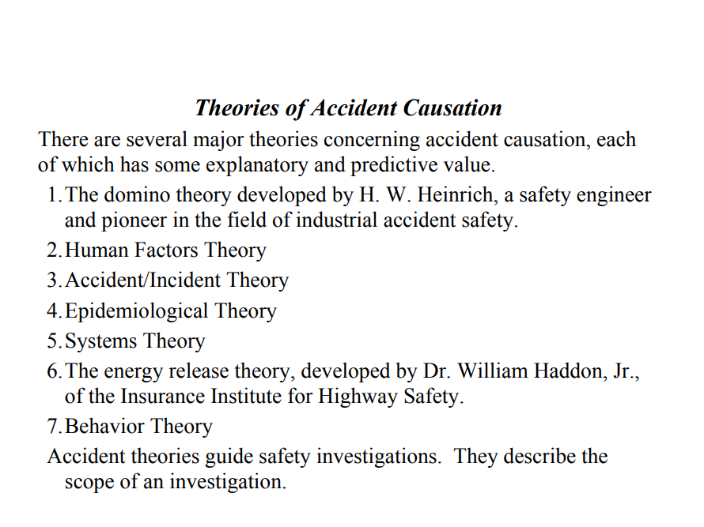

Slide 2
1. Heinrich's Domino Theory
According to Heinrich, an "accident" is one factor in a sequence that may lead to an injury.
The factors can be visualized as a series of dominoes standing on edge; when one falls, the linkage required for a chain reaction is completed.
Each of the factors is dependent on the preceding factor
After studying the reports of 75,000 industrial accidents, Heinrich concluded that
  88 percent of industrial accidents are caused by unsafe acts committed by fellow workers.
  10 percent of industrial accidents are caused by unsafe conditions.
  2 percent of industrial accidents are unavoidable.
Heinrich’s study laid the foundation for his Axioms of Industrial Safety and his theory of accident causation, which came to be known as the domino theory.

Slide 3
Heinrich’s Axioms of Industrial Safety
Injuries result from a series of preceding factors.
Accidents occur as the result of physical hazard or an unsafe act.
Most accidents are the result of unsafe behavior.
Unsafe acts and hazards do not always result in immediate accidents and injuries.
Understanding why people commit unsafe acts helps to establish guidelines for corrective actions.
The severity of the injury is largely fortuitous and the accident that caused it is preventable.
Best accident prevention techniques are analogous to best quality /productivity techniques.
Management should assume safety responsibilities.
The supervisor is the key person in the prevention of industrial accidents.
Cost of accidents include both direct costs and indirect costs

Slide 4
Heinrich’s Axioms of Industrial Safety
According to Heinrich, these axioms encompass the fundamental body of knowledge that must be understood by decision makers interested in preventing accidents.
Any accident prevention program that takes all 10 axioms into account is more likely to be effective than a program that leaves out one or more axioms

Slide 5
Heinrich’s Axioms of Industrial Safety
According to Heinrich, there are five factors in the sequence of events leading up to an accident. These factors can be summarized as follows:
  Ancestry and social environment. Negative character traits that may lead people to behave in an unsafe manner can be inherited (ancestry)or acquired as a result of the social environment
  Fault of person Negative character traits, whether inherited or acquired, are why people behave in an unsafe manner and why hazardous conditions exist.
  Unsafe act/mechanical or physical hazard .Unsafe acts committed by people and mechanical or physical hazards are the direct causes of accidents.
  Accident. Typically, accidents that result in injury are caused by falling or being hit by moving objects.
  Injury. Typical injuries resulting from accidents include lacerations and fractures. •

Slide 6
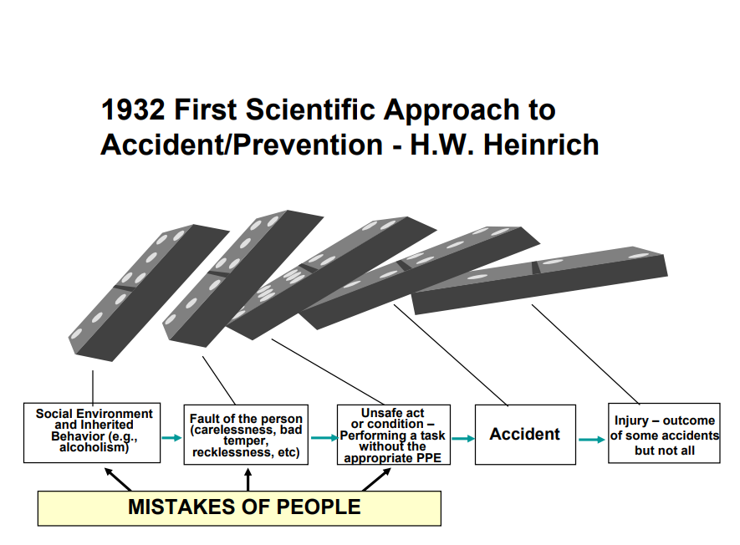

Slide 7
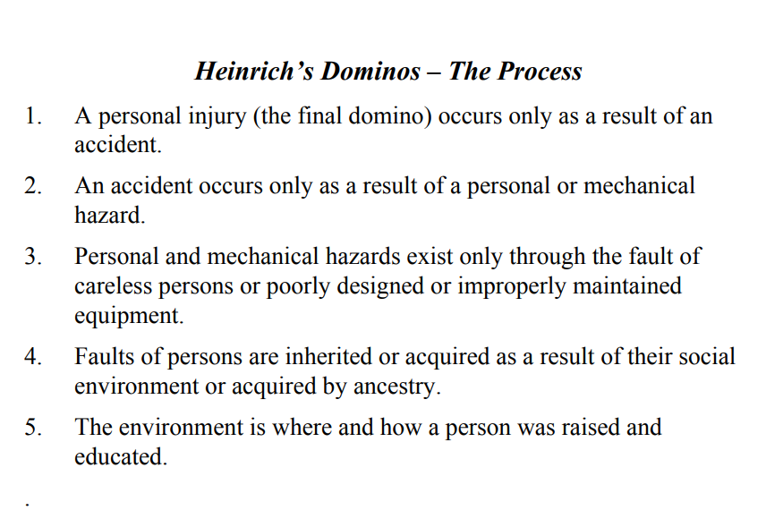

Slide 8
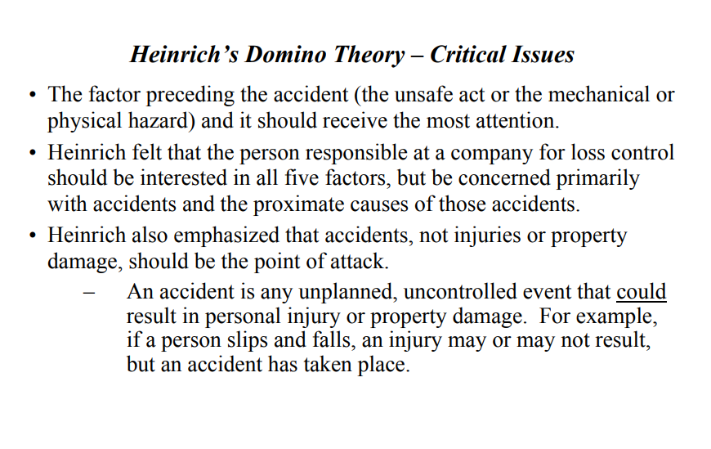

Slide 9
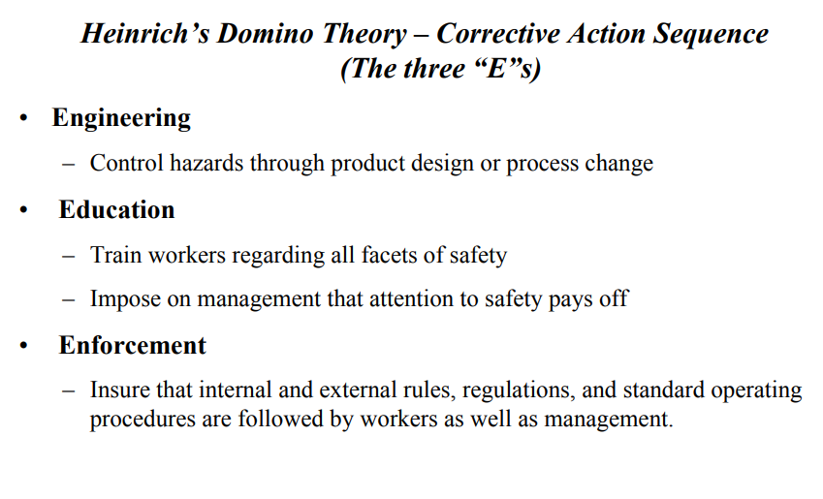

Slide 10
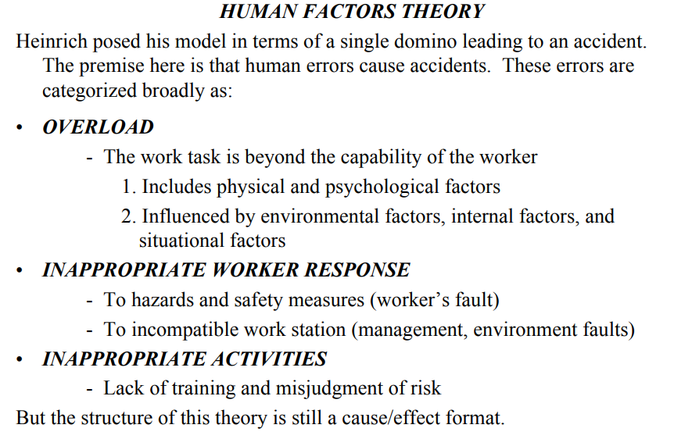

Slide 11
2. Human Factors Theory

Slide 12
Overload
Overload amounts to an imbalance between a person’s capacity at any given time and the load that person is carrying in a given state.
A person’s capacity is the product of such factors as his or her natural ability, training, state of mind, fatigue, stress, and physical condition.
The load that a person is carrying consists of tasks for which he or she is responsible and added burdens resulting from
  Environmental factors (noise, distractions, and so on)
  Internal factors (personal problems, emotional stress, and worry)
  Situational factors (level of risk, unclear instructions, and so on).
The state in which a person is acting is the product of his or her motivational and arousal levels

Slide 13
Inappropriate Response and Incompatibility
How a person responds in a given situation can cause or prevent an accident.
If a person detects a hazardous condition but does nothing to correct it, he or she has responded inappropriately.
If a person removes a safeguard from a machine in an effort to increase output, he or she has responded inappropriately.
If a person disregards an established safety procedure, he or she has responded inappropriately. Such responses can lead to accidents.
In addition to inappropriate responses, this component includes workstation incompatibility.
The incompatibility of a person’s workstation with regard to size, force, reach, feel, and similar factors can lead to accidents and injuries

Slide 14
Inappropriate Activities
Human error can be the result of inappropriate activities
An example of an inappropriate activity is a person who undertakes a task that he or she doesn’t know how to do.
Another example is a person who misjudges the degree of risk involved in a given task and proceeds based on that misjudgement.
Such inappropriate activities can lead to accidents and injuries.

Slide 16
3. Accident/Incident Theory
The accident/incident theory is an extension of the human factors theory. Sometimes referred to as the Petersen accident/incident theory.
Petersen introduced such new elements as ergonomic traps, the decision to err, and systems failures, while retaining much of the human factors theory.
In this model, overload, ergonomic traps, or a decision to err lead to human error.
The decision to err may be conscious and based on logic, or it may be unconscious.
A variety of pressures such as deadlines, peer pressure, and budget factors can lead to unsafe behaviour
Another factor that can influence such a decision is the “It won’t happen to me” syndrome.
The systems failure component is an important contribution of Petersen’s theory.
First, it shows the potential for a causal relationship between management decisions or management behavior and safety.
Second, it establishes management’s role in accident prevention as well as the broader concepts of safety and health in the workplace.

Slide 18
3. Accident/Incident Theory
Following are just some of the different ways that systems can fail, according to
Petersen’s theory:
  Management does not establish a comprehensive safety policy.
  Responsibility and authority with regard to safety are not clearly defined.
  Safety procedures such as measurement, inspection, correction, and investigation ignored or given insufficient attention.
  Employees do not receive proper orientation.
  Employees are not given sufficient safety training

Slide 19
4. EPIDEMIOLOGICAL THEORY OF ACCIDENT
CAUSATION
Traditionally, safety theories and programs have focused on accidents and the resulting injuries.
However, the current trend is toward a broader perspective that also encompasses the issue of industrial hygiene.
Industrial hygiene concerns environmental factors that can lead to sickness, disease, or other forms of impaired health.
This trend has, in turn, led to the development of an epidemiological theory of accident causation.
Epidemiology is the study of causal relationships between environmental factors and disease.

Slide 20
4. EPIDEMIOLOGICAL THEORY OF ACCIDENT
CAUSATION
The epidemiological theory holds that the models used for studying and determining these relationships can also be used to study causal relationships between environmental factors and accidents or diseases
The key components are predispositional characteristics and situational characteristics.
These characteristics, taken together, can either result in or prevent conditions that may result in an accident.
For example, if an employee who is particularly susceptible to peer pressure (predispositional characteristic) is pressured by his coworkers (situational characteristic) to speed up his operation, the result will be an increased probability of an accident

Slide 21
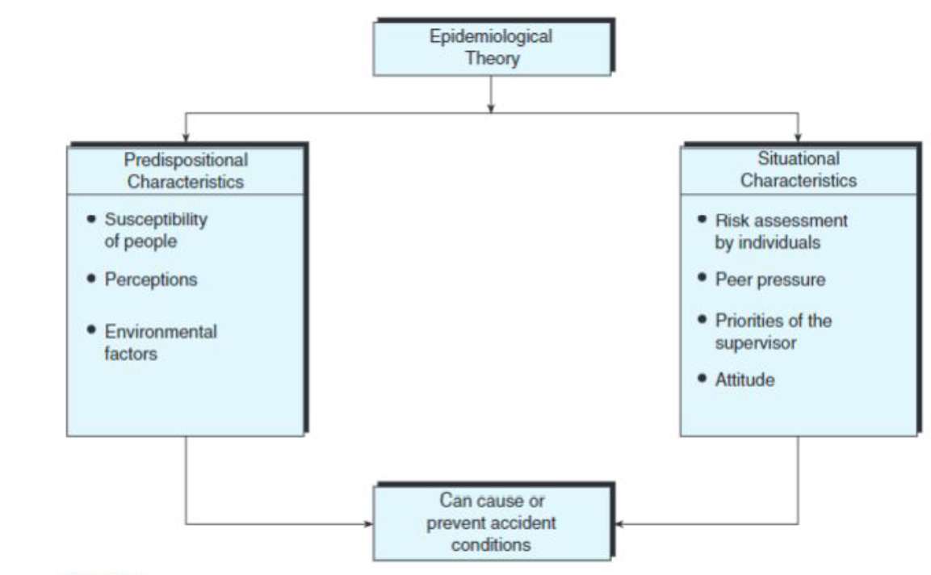

Slide 22
5. SYSTEMS THEORY OF ACCIDENT CAUSATION
A system is a group of regularly interacting and interrelated components that together form a unified whole. This definition is the basis for the systems theory of accident causation.
This theory views a situation in which an accident may occur as a system comprised of the following components: person (host), machine (agency), and environment.
The likelihood of an accident occurring is determined by how these components interact.
Under normal circumstances chances of an accident is low. Rather than looking at the environment as being full of hazards and people prone to errors, system safety assumes harmony (steady state) exists between individuals and the work environment.

Slide 23
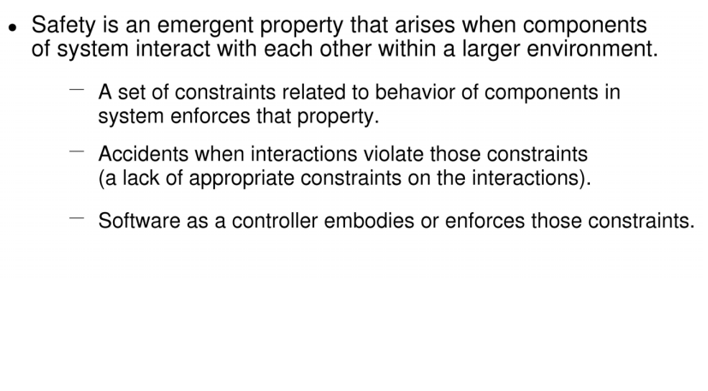
5. SYSTEMS THEORY OF ACCIDENT CAUSATION

Slide 24
5. SYSTEMS THEORY OF ACCIDENT CAUSATION
Changes in the patterns of interaction can increase or reduce the probability of an accident.
  For example, an experienced employee who operates a numerically controlled five axis machining centre in a shop environment may take a two-week vacation. Her temporary replacement may be less experienced. This change in one component of the system (person/host) increases the probability of an accident.
  Such a simple example is easily understood. However, not all changes in patterns of interaction are this simple. Some are so subtle that their analysis may require a team of people, each with a different type of expertise.
The primary components of the systems model are the person/ machine/ environment, information, decisions, risks, and the task to be performed.
Each of the components has a bearing on the probability that an accident will occur.

Slide 25
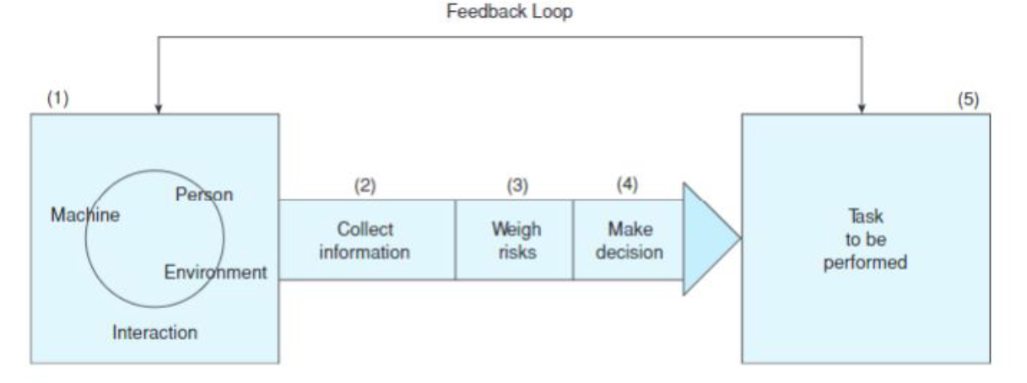
5. SYSTEMS THEORY OF ACCIDENT CAUSATION

Slide 26
5. SYSTEMS THEORY OF ACCIDENT CAUSATION
As this model shows, even as a person interacts with a machine within an environment, three activities take place between the system and the task to be performed.
Every time a task must be performed, there is the risk that an accident may occur.
Sometimes the risks are great; at other times, they are small.
This is where information collection and decision making come in.
Based on the information that has been collected by observing and mentally noting the current circumstances, the person weighs the risks and decides whether to perform the task under existing circumstances.

Slide 27
5. SYSTEMS THEORY OF ACCIDENT CAUSATION
For example, say a machine operator is working on a rush order that is behind schedule.
  An important safety device has malfunctioned on his machine.
  Simply taking it off will interrupt work for only five minutes, but it will also increase the probability of an accident.
  However, replacing it could take up to an hour. The operator and his supervisor may assess the situation (collect information), weigh the risks, and make a decision to proceed.
  If their information was right and their assessment of the risks accurate, the task will probably be accomplished without an accident.
However, the environment in which the machine operator is working is unusually hectic, and the pressure to complete an order that is already behind schedule is intense.

Slide 28
5. SYSTEMS THEORY OF ACCIDENT CAUSATION
These factors are stressors that can cloud the judgment of those collecting information, weighing risks, and making the decision.
When stressors are introduced between points 1 and 3, the likelihood of an accident increases.
For this reason, five factors should be considered before beginning the process of collecting information, weighing risks, and making a decision:
  Job requirements
  The workers’ abilities and limitations
  The gain if the task is successfully accomplished
  The loss if the task is attempted but fails
  His loss if the task is not attempted
These factors can help a person achieve the proper perspective before performing the above mentioned tasks. It is particularly important to consider these factors when stressors such as noise, time constraints, or pressure from a supervisor may tend to cloud one’s judgment.

Slide 29
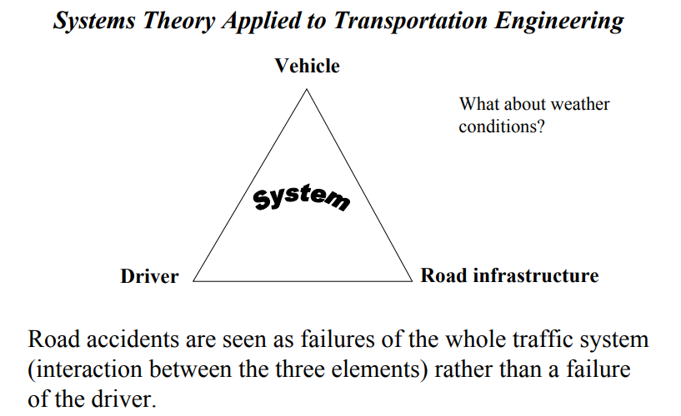

Slide 30
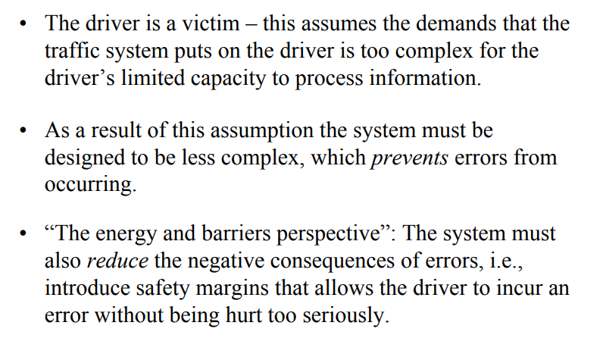

Slide 31
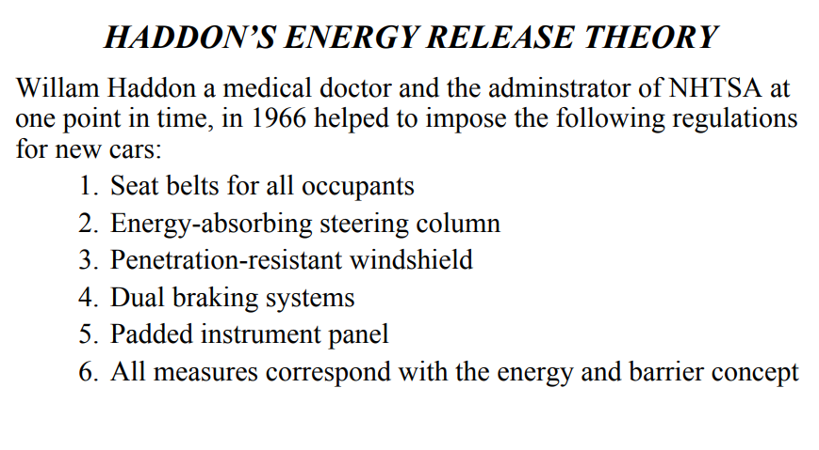

Slide 32
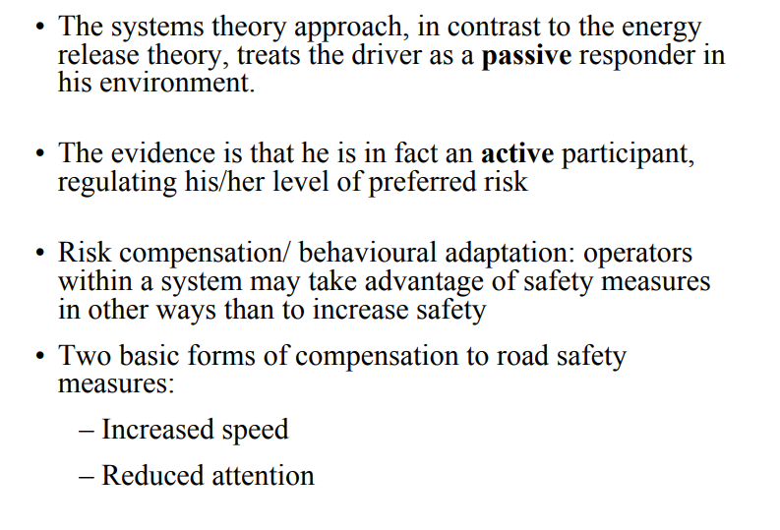

Slide 33
6. BEHAVIORAL THEORY OF ACCIDENT
CAUSATION
The behaviour theory of accident causation and prevention is often referred to as behaviour -based safety (BBS)
BBS has both proponents and critics.
One of the most prominent proponents of BBS is E. Scott Geller, a senior partner of Safety Performance Solutions, Inc., and a professor of psychology.
It is appropriate that Geller is a professional psychologist because BBS is the application of behavioural theories from the field of psychology to the field of occupational safety.

Slide 34
6. BEHAVIORAL THEORY OF ACCIDENT
CAUSATION
According to Geller, there are seven basic principles of BBS:
  Intervention that is focused on employee behaviour;
  Identification of external factors that will help understand and improve employee behaviour (from the perspective of safety in the workplace);
  Direct behaviour with activators or events antecedent to the desired behaviour, and motivation of the employee to behave as desired with incentives and rewards that will follow the desired behaviour;
  Focus on the positive consequences that will result from the desired behaviour as a way to motivate employees;
  Application of the scientific method to improve attempts at behaviour interventions;
  Use of theory to integrate information rather than to limit possibilities; and
  Planned interventions with the feelings and attitudes of the individual employee in mind.

Slide 35
7. COMBINATION THEORY OF ACCIDENT CAUSATION
There is often a degree of difference between any theory of accident causation and reality.
The various models presented with their corresponding theories attempt to explain why accidents occur.
For some accidents, a given model may be very accurate. For others, it may be less so. Often the cause of an accident cannot be adequately explained by just one model or theory.
Thus, according to the combination theory, the actual cause may combine parts of several different models. Safety personnel should use these theories as appropriate both for accident prevention and accident investigation.
However, they should avoid the tendency to try to apply one model to all accidents

